Slide 1
Credential Harvesting Phishing Attack
Presentation By:
Cameron Wallace

Slide 2
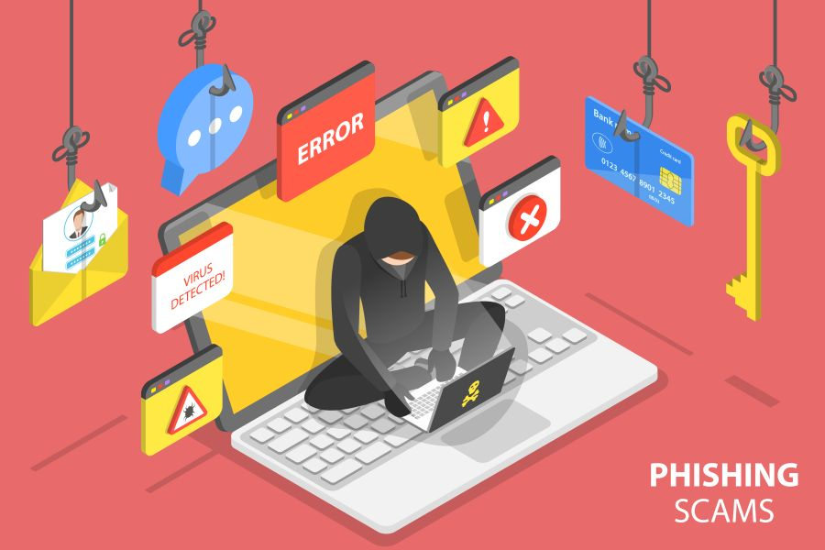
Social Engineering (Security)
The tactic of using psychological manipulation or deception to influence a victim into divulging sensitive information.
This sensitive information is then used by the attacker to compromise and gain access to systems for the purpose of harvesting data to be used as ransom, blackmail, or any number of other malicious purposes.
Social Engineering Security attacks often differ from other forms of “cons” (confidence trick) because it is usually just one step as a part of a larger fraud attack.

Slide 3
Phishing Attack
When a malicious threat actor attempts to acquire a victim’s sensitive information such as usernames, passwords, or financial information by masquerading as a trustworthy individual or organization via email or SMS text messaging.
Phishing scams often prey upon victims by trying to foster a sense of urgency Phishing messages create a sense of urgency, curiosity, or fear in the recipients of the message.
The message will lure victims into revealing sensitive information, clicking on links to malicious websites, or opening attachments that contain malware.

Slide 4
APWG Phishing Attacks Statistics
The number of phishing attacks are on the rise with a record number occuring in the third quarter of 2022. (1)
Of all reported data breaches, 82% involved a human element, including via phishing and the use of stolen credentials. (2)
In 2021, phishing was the most prevalent threat in the US, with 323,972 victims—up 34% compared to the previous year. (3)
33% of organizations are not providing any cybersecurity training to employees who work remotely, despite most of these staff members having access to sensitive data. (4)

Slide 5
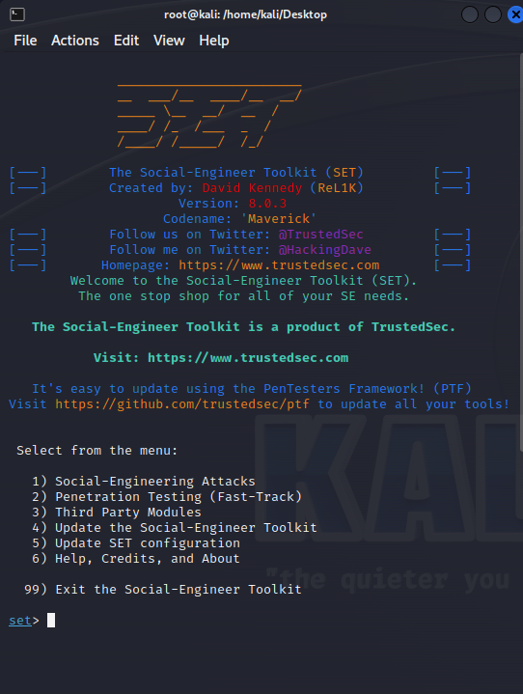
The Social-Engineer Toolkit (SET)
The Social-Engineer Toolkit is an open-source, Python-driven penetration-testing tool designed to allow users to build custom attacks that target the human element in a believable fashion.
There are dozens of different modules and methods of attack that a user can employ.
https://github.com/trustedsec/social-engineer-toolkit
Install Requirements:
Python3
Pip3

Slide 6
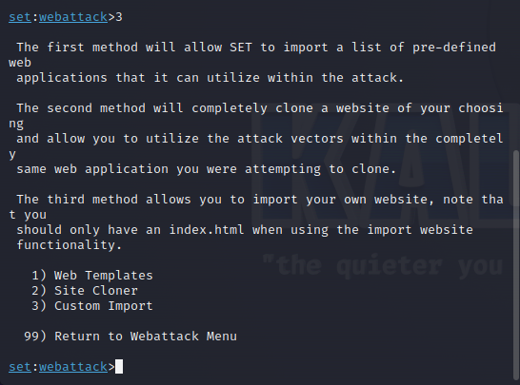
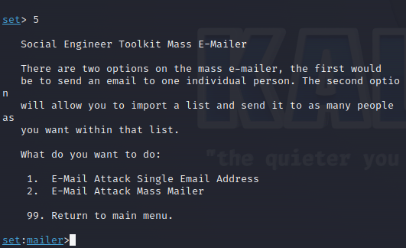
Credential Harvester Attack + Mass Mailer Attack
Credential Harvester Attack:
Clones a website that has a username and password field and harvests all data entries into those fields and returns them to the attacker.
Mass Mailer Attack:
Allows for emails to be sent from within the command line to either one person or via a mailing list.
Has pre-defined templates and customizable settings for subject, body, etc.

Slide 7
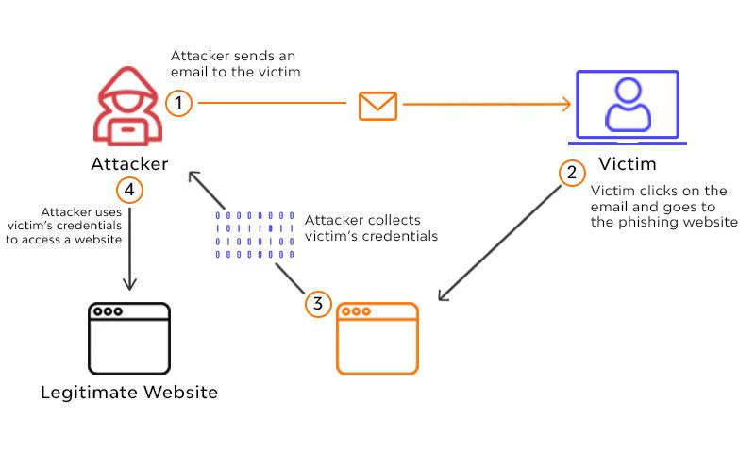
Visualization Preview

Slide 8



Tools Utilized:
Kali Linux Virtual Machine via Oracle VM VirtualBox
The Social-Engineer Toolkit (SET) via TrustedSec (5)
Google - Gmail

Slide 9
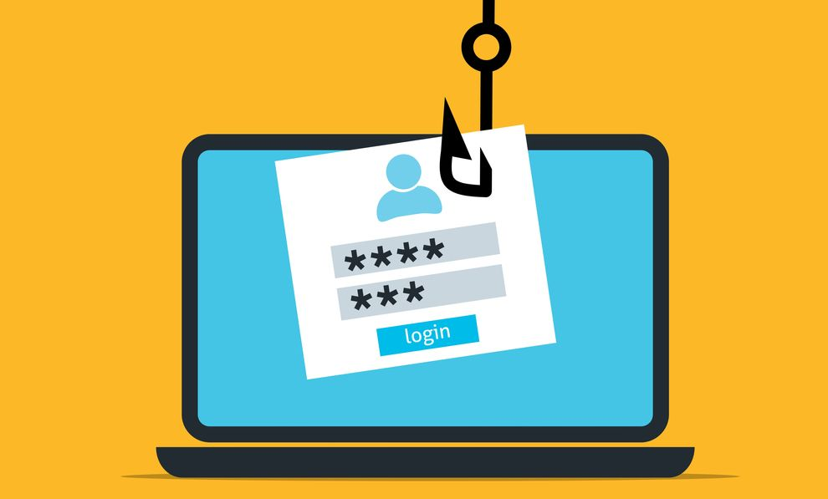
Credential Harvesting Phishing Attack Live Demo

Slide 10
Summary of the Attack
Using the site-cloner within the SET, the login page for Google.com was cloned to an IP owned by the attacker.
Crafted an email using the SET Mass Mailer featuring a fake sender and a malicious link hidden via the <a> HTML element.
The malicious link in the email was opened, providing the victim with the cloned site.
Login credentials were entered and returned to the attacker.
The credentials were then used to access the victim’s account.

Slide 11
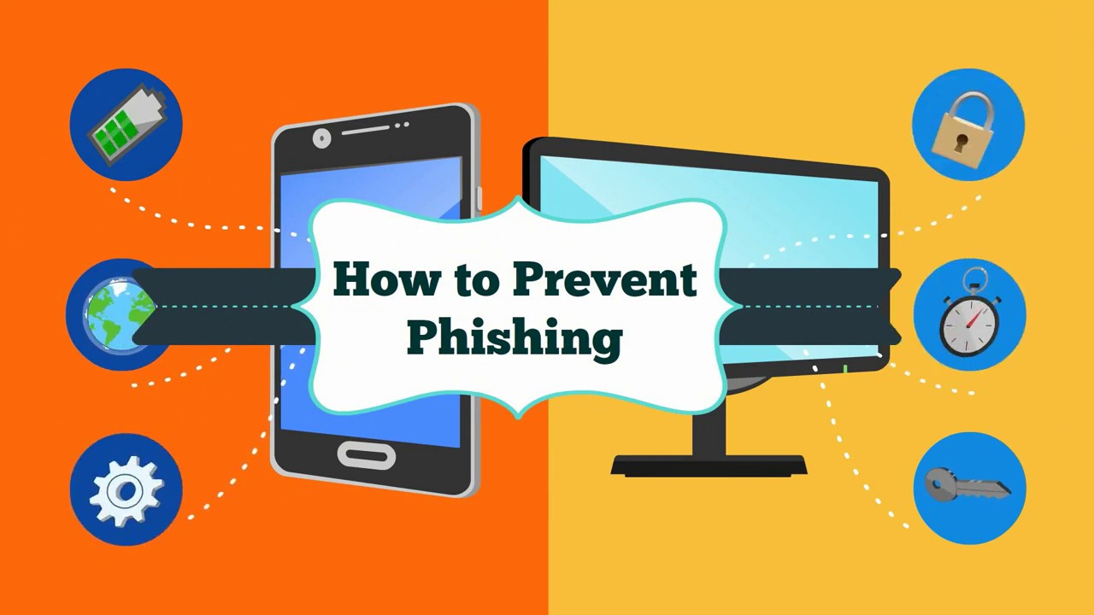
Mitigating Phishing Attacks
Train employees to be able to recognize the signs of a phishing attempt, and how to properly report such attempts.
Utilize multi-factor authentication for all accounts.
Use anti-spam filters to target certain words, phrases, and other pre-defined blacklists to automatically move phishing emails to spam folders.
Implement email warning banners within your organization to automatically flag all emails from outside of your organization.
Never respond to suspicious emails and never open any links or attachments included in them.
If you need to check a link or attachment, do so using a tool that will not compromise your network or system.

Slide 12
Pages and Works Cited:
APWG 2022 Q3 Trends Report: https://docs.apwg.org/reports/apwg_trends_report_q3_2022.pdf
Verizon 2022 Data Breach Investigations Report: https://www.verizon.com/business/en-gb/resources/reports/dbir/
FBI Internet Crime Report: https://www.ic3.gov/Media/PDF/AnnualReport/2021_IC3Report.pdf
Hornetsecurity Company Training Report: https://www.hornetsecurity.com/en/press-releases/1-in-3-organizations-does-not-provide-any-cybersecurity-training-to-remote-workers/
TrustedSec SET Official Page: https://www.trustedsec.com/tools/the-social-engineer-toolkit-set/
Crowdstrike Security 101 - Phishing: https://www.crowdstrike.com/cybersecurity-101/phishing/
TrustedSec Social-Engineer Toolkit Github: https://github.com/trustedsec/social-engineer-toolkit

